Slide 1
Food Delivery Performance Dashboard
Prepared by: Rucha
Tool: Tableau Desktop
Dataset: 45,593 Records
Portfolio & College Submission

Slide 2
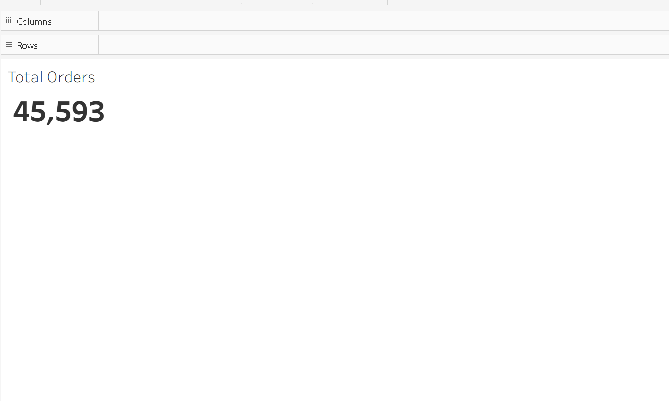
Total Orders
Key Insight
A total of 45,593 delivery orders were analyzed, indicating a large operational dataset.

Slide 3

Average Rating
Key Insight
The average customer rating is 4.634, showing consistently high customer satisfaction.

Slide 4
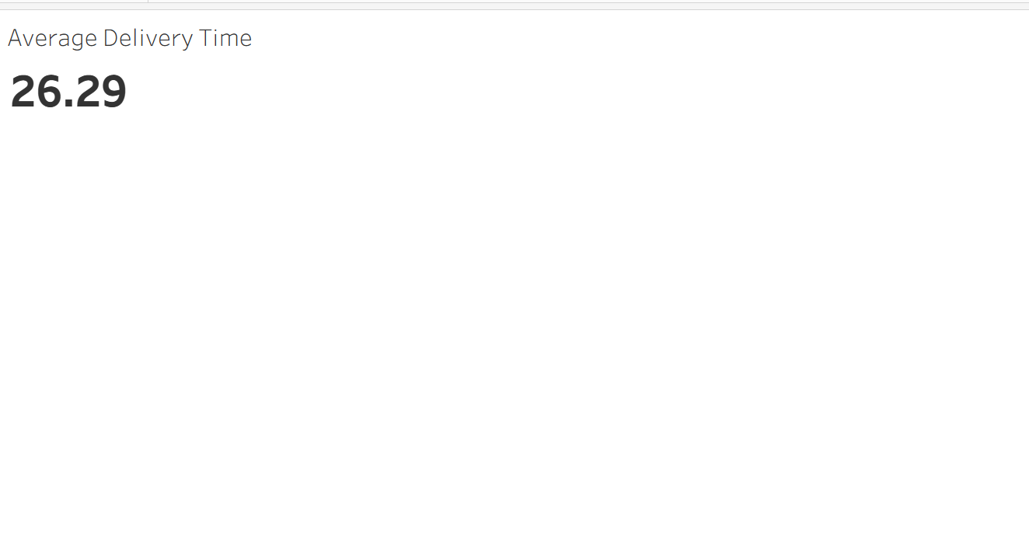
Average Delivery Time
Key Insight
The average delivery time is 26.29 minutes, indicating efficient delivery performance.

Slide 5
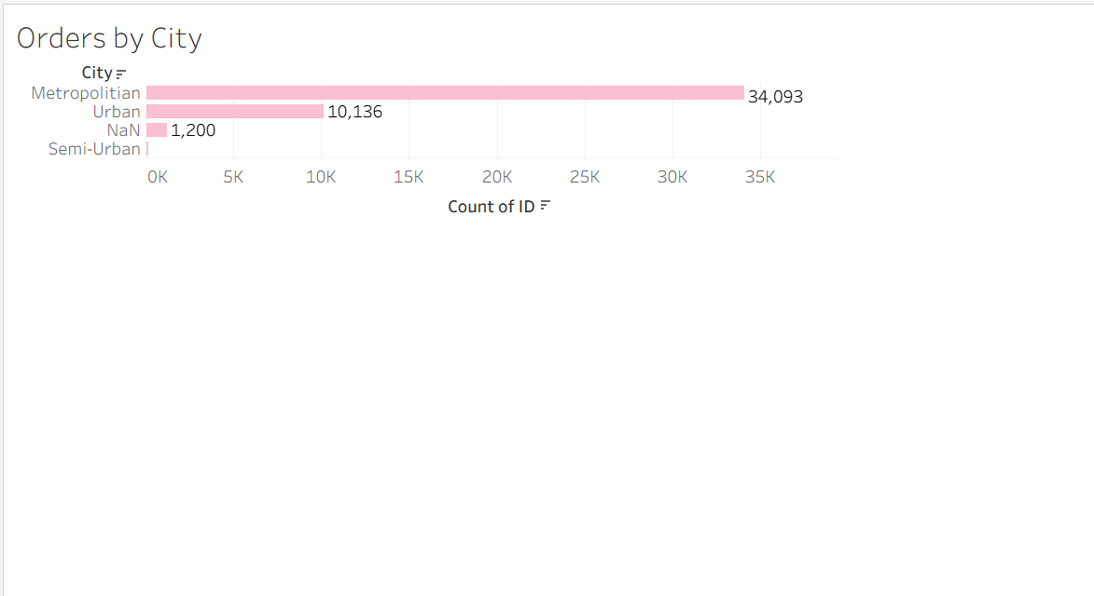
Orders by City
Key Insight
Metropolitan cities generated the highest number of orders, followed by Urban areas.

Slide 6
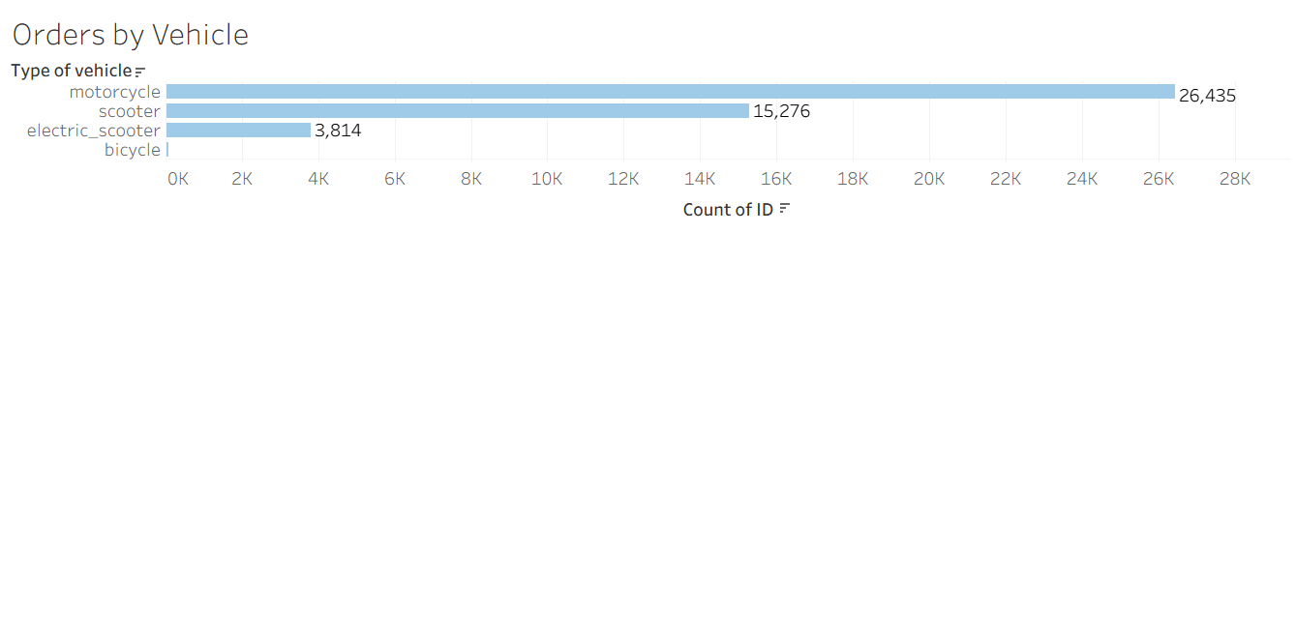
Orders by Vehicle
Key Insight
Motorcycles handled the majority of deliveries, making them the primary delivery vehicle.

Slide 7
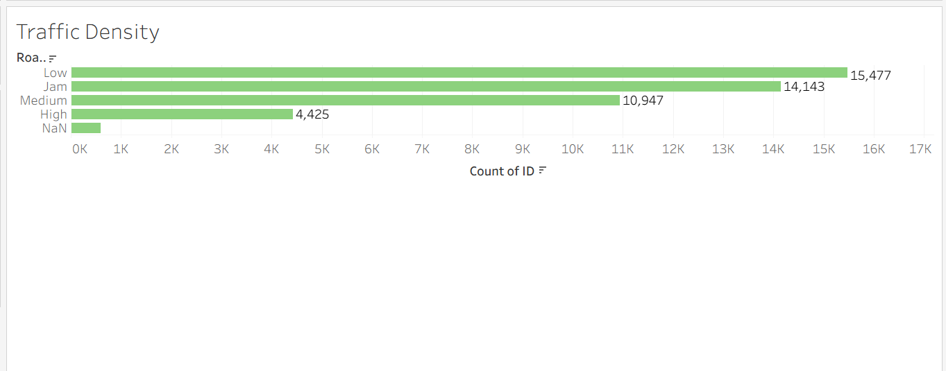
Traffic Density
Key Insight
Most deliveries occurred during Low and Jam traffic conditions, while High traffic accounted for fewer deliveries.

Slide 8
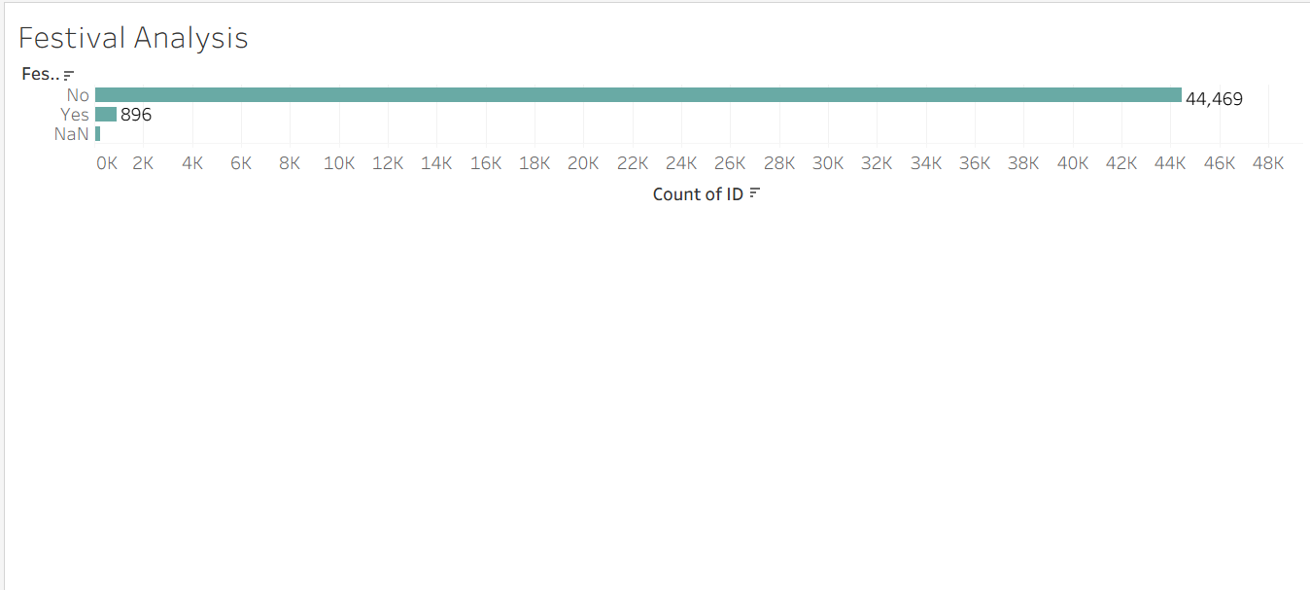
Festival Analysis
Key Insight
Most orders were placed during non-festival periods, indicating steady day-to-day demand.

Slide 9
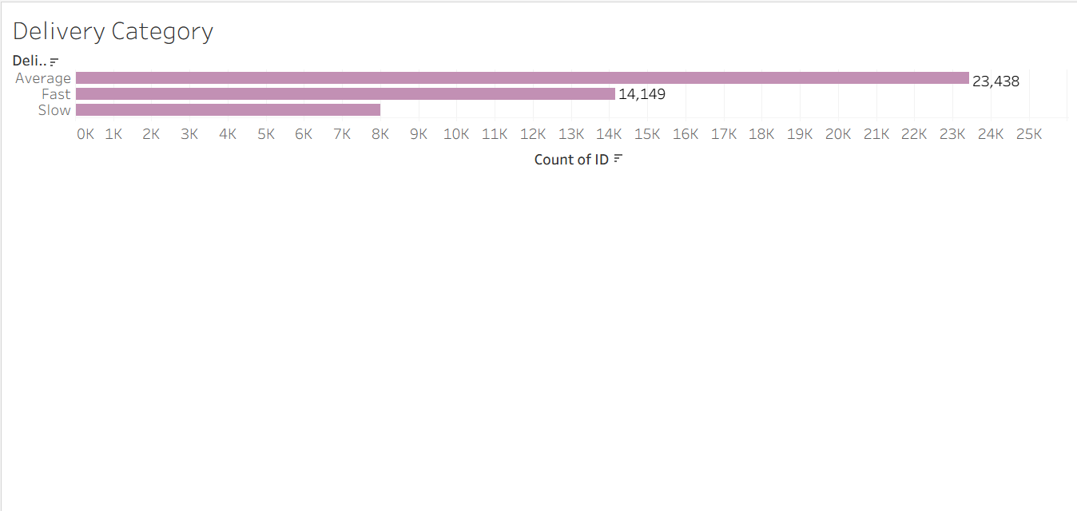
Delivery Category
Key Insight
Most deliveries fall into the Average category, followed by Fast deliveries.

Slide 10
Overall Business Insights
• 45,593 delivery orders were analyzed using Tableau.
• Average customer rating is 4.634, indicating high customer satisfaction.
• Average delivery time is 26.29 minutes, showing efficient operations.
• Metropolitan cities generated the highest number of food delivery orders.
• Motorcycles are the primary delivery vehicle used by delivery partners.
• Most deliveries occurred during non-festival periods.
• Most deliveries fall under the Average delivery category.
• Interactive filters allow managers to analyze the dashboard by city, vehicle and festival.

Slide 11
Recommendations
• Increase delivery partners in Metropolitan cities to meet high demand.
• Optimize delivery routes during Jam traffic conditions.
• Promote electric scooters to reduce operational costs and emissions.
• Maintain high customer ratings through continuous delivery partner training.
• Use dashboard insights for workforce planning and business decisions.

Slide 12
Overall Conclusion
• This Tableau dashboard provides a comprehensive view of food delivery operations through interactive visualizations.
• It enables stakeholders to monitor KPIs, evaluate delivery performance, identify operational trends and make data-driven decisions.
• The project demonstrates practical skills in data visualization, KPI analysis and business intelligence using Tableau.

Slide 13
Thank You
• Thank You!
• Questions & Discussion

